Slide 1
Incorporating Evidence-Based Practice (EBP) into Fieldwork Experiences
Lora May Swart BSAS, COTA/L, State College of Florida
Helene Lieberman MS, OTR/L, Nova Southeastern University

Slide 2



Slide 3
Evidence-Based Practice (EBP)
GOALS:
Define Evidence-Based Practice
Describe the relationship to the OT Code of Ethics
Articulate the benefits of Evidence-based Practice
Introduce Levels of Evidence for Research
Identify sources to locate scholarly literature and understand information including the quality of the source of information
Ability to use Evidence-based practice decisions with collaboration of OT
Identify 3 ways to incorporate Evidence-based practice into your Fieldwork students’ experience

Slide 4
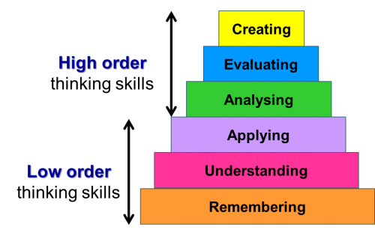
Teaching/ Learning Process
Student Learning: Bloom’s Taxonomy
ateneu.xtec.cat

Slide 5
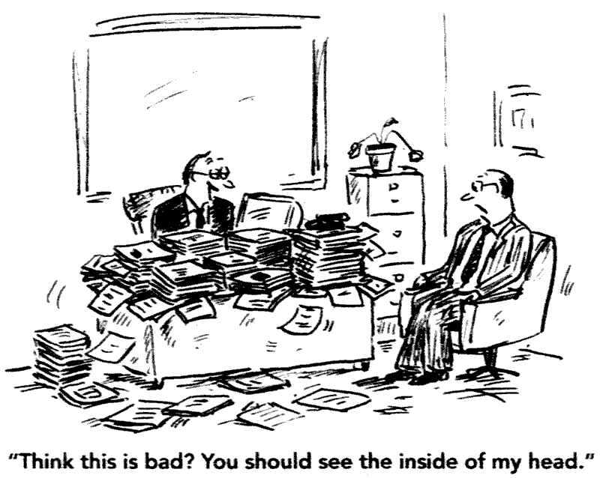
Student Learning
A student that is out of sync or scattered causes misunderstandings in the clinic between the student and FWE.
This causes a loss of confidence and promotes the student to resort to imitating what they think the FWE wants them to do.
  This is a missed opportunity, limiting the students to think like a practitioner
Notes:
Goal is to have students start thinking on their own and develop problem solving skills

Slide 6
Teaching/ Learning Process
Bergner (2018) discusses incorporating occupation-based models with students.
FWE:
    Develop an understanding of the different occupation-based models
    Aid the student to identify & classify which models are being used
    The student applies and integrates the model
    Use a layering approach

Slide 7
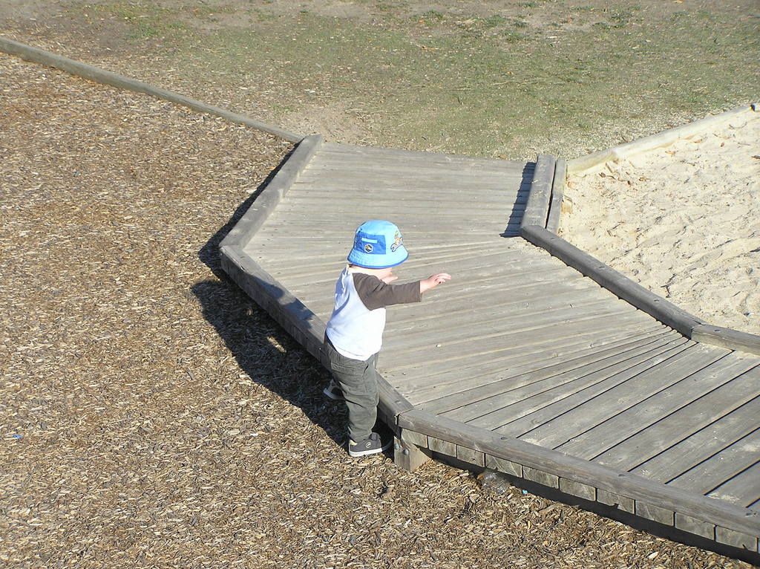
Student Learning
Having a model to process and integrate the information provides a huge step in their learning and understanding.
Improves confidence in unfamiliar situations
Provides a stronger professional identity
Increases problem solving abilities

Slide 8
Occupation-based Models for Student Learning
Examples:
Person Environment Occupation Model (PEO), Law et al (1996)
Occupation-al Adaptation, Schkade & Schult (1992)
Model of Human Occupation (MOHO), Kielhofner (1980)

Slide 9
How to identify use of Occupation-based models
“…applying is a necessary step to developing a strong professional identity. Without a strong professional identity, students fall back on fragmented skill development and fail to prioritize interventions or see the big picture.” (Bergner, 2018)
Develop clinical reasoning skills
Review the basics
Talk through it with FWE

Slide 10
Fieldwork Educator vs. Practitioner
Role delineation
Practitioners
Being a clinician does not prepare one to be an educator
Practice area guides student’s learning experience
Disassociation of roles b/w practitioner/educator
Focus on supervision vs. instructional design
Educators
Provided with little training to acquire a student
Need to assume a stronger identity as an educator
Observe, assess & give feedback based on student competency, documentation, time management, etc.

Slide 11

Ongoing health care changes at both the federal and state level have had a significant impact on how health care is provided.
Changes in reimbursement have caused insurance providers to require more efficient and effective therapy services.

Slide 12
EVIDENCE-BASED PRACTICE
Definition-AOTA
Evidence-based practice is based on the integration of critically appraised research results with the clinical expertise, and the client’s preferences, beliefs and values.
  AOTA Evidence-Based Practice Tools and Resources (page) http://www.aota.org/Practice/Researchers/EBP-Resources.aspx
  AOTA has “Practice Guidelines”
  http://www.aota.org/Practice/Researchers/practice-guidelines.aspx

Slide 13
EVIDENCE-BASED PRACTICE
Definition-AOTA
Synonyms for evidence:
  Data
  Documentation
  Indication
  Sign
  Proof
  Authentication
  Confirmation

Slide 14

Quality Service Provided
“Supplying the evidence for practice to both the consumer and the insurance provider can reinforce the value and meaning of the foundation of our profession”

Slide 15
Code of Ethics and Ethics Standards
Demand practitioners fully inform our clients of the
  Nature
  Risks
  Potential outcomes
Of any intervention
Also to:
Stay current with emerging knowledge important of our practice

Slide 16
Code of Ethics and Ethics Standards:
Consider this-
Unsubstantiated beliefs or claims are insufficient in themselves to support professional activity in an increasingly competitive: quality, safety, and cost conscious; and accountability-demanding healthcare context

Slide 17
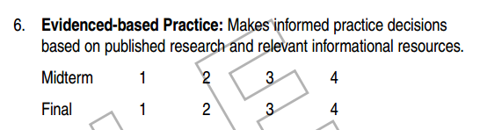
AOTA’s
OTA Fieldwork Performance Evaluation Item #6
You are graded on your practice decisions!

Slide 18
AOTA’s
OT Fieldwork Performance Evaluation Item #19
19. Uses evidence from published research and relevant resources to make informed intervention decisions.
        Midterm 1 2 3 4
          Final 1 2 3 4

Slide 19
ACCREDITATION STANDARDS FOR AN ASSOCIATE-DEGREE-LEVEL EDUCATIONAL PROGRAM FOR THE OCCUPATIONAL THERAPY ASSISTANT-B.6.1. Professional Literature and Scholarly Activities
Locate and demonstrate understanding of professional literature, including the quality of the source of information, to make evidence-based practice decisions in collaboration with the occupational therapist.
Explain how scholarly activities and literature contribute to the development of the profession

Slide 20
ACCREDITATION STANDARDS FOR A BACCALAUREATE-DEGREE-LEVEL EDUCATIONAL PROGRAM FOR THE OCCUPATIONAL THERAPY ASSISTANT-B. 6.1. Professional Literature and Scholarly Activities
Locate and demonstrate understanding of professional literature, including the quality of the source of information, to make evidence-based practice decisions in collaboration with the occupational therapist.
Explain how scholarly activities and literature contribute to the development of the profession.

Slide 21
ACCREDITATION STANDARDS FOR A MASTER’S-DEGREE-LEVEL EDUCATIONAL PROGRAM FOR THE OCCUPATIONAL THERAPIST
B.6.1. Scholarly Study
Critique quantitative and qualitative research in order to analyze and evaluate scholarly activities, which contribute to the development of a body of knowledge. This includes the:
o Level of evidence
o Validity of research studies
o Strength of the methodology
o Relevance to the profession of occupational therapy.

Slide 22
ACCREDITATION STANDARDS FOR A DOCTORAL-DEGREE-LEVEL EDUCATIONAL PROGRAM FOR THE OCCUPATIONAL THERAPIST
B.6.1. Scholarly Study
research in order to analyze and evaluate scholarly activities, which contribute to the development of a body of knowledge. This includes the:
o Level of evidence
o Validity of research studies
o Strength of the methodology
o Relevance to the profession of occupational therapy

Slide 23
ACCREDITATION STANDARDS FOR A DOCTORAL-DEGREE-LEVEL EDUCATIONAL PROGRAM FOR THE OCCUPATIONAL THERAPIST
B.6.1. Scholarly Study
Locate, select, analyze, and evaluate scholarly literature to make evidence-based decisions.
Participate in scholarly activities that align with current research priorities and advances knowledge translation, professional practice, service delivery, or professional issues (e.g., Scholarship of Integration, Scholarship of Application, Scholarship of Teaching and Learning).
This may include a literature review that requires analysis and synthesis of data. Systematic reviews that require analysis and synthesis of data meet the requirement for this Standard. A research project is not required for this Standard, and narrative reviews do not meet this Standard.

Slide 24
ACCREDITATION STANDARDS FOR AN ASSOCIATE-DEGREE-LEVEL EDUCATIONAL PROGRAM FOR THE OCCUPATIONAL THERAPY ASSISTANT
B.6.2. Quantitative and Qualitative Methods
Understand the difference between quantitative and qualitative research studies.
B.6.3. Scholarly Reports
Demonstrate the skills to understand a scholarly report.

Slide 25
ACCREDITATION STANDARDS FOR A BACCALAUREATE-DEGREE-LEVEL EDUCATIONAL PROGRAM FOR THE OCCUPATIONAL THERAPY ASSISTANT
B.6.2. Quantitative and Qualitative Methods
Understand the use of quantitative and qualitative methods for data analysis that include:
Basic descriptive, correlational, and inferential quantitative statistics.
Analysis and synthesis of qualitative data.
B.6.3. Scholarly Reports
Demonstrate the skills to understand a scholarly report

Slide 26
ACCREDITATION STANDARDS FOR A MASTER’S-DEGREE-LEVEL EDUCATIONAL PROGRAM FOR THE OCCUPATIONAL THERAPIST
B.6.2. Quantitative and Qualitative Methods
Demonstrate an understanding and use of quantitative and qualitative methods for data analysis to include:
Basic descriptive, correlational, and inferential quantitative statistics.
Analysis and synthesis of qualitative data.
B.6.3. Scholarly Reports
Demonstrate the skills necessary to write a scholarly report in a format for presentation or publication, which may be made available to professional or public audiences.

Slide 27
ACCREDITATION STANDARDS FOR A DOCTORAL-DEGREE-LEVEL EDUCATIONAL PROGRAM FOR THE OCCUPATIONAL THERAPIST
B.6.2. Quantitative and Qualitative Methods
Select, apply, and interpret quantitative and qualitative methods for data analysis to include:
Basic descriptive, correlational, and inferential quantitative statistics.
Analysis and synthesis of qualitative data.
B.6.3. Scholarly Reports
Create scholarly reports appropriate for presentation or for publication in a peer-reviewed journal that support skills of clinical practice. The reports must be made available to professional or public audiences.

Slide 28
Benefits from use of EBP
Accuracy
Cost- Effectiveness
Efficiency
Benefits the
Consumer
Clinical Reasoning
Notes:
Give examples from different practice settings

Slide 29

Benefits from use of EBP
EBP also allows the OT practitioner to educate the client regarding the effectiveness of the evaluation and intervention processes chosen.

Slide 30
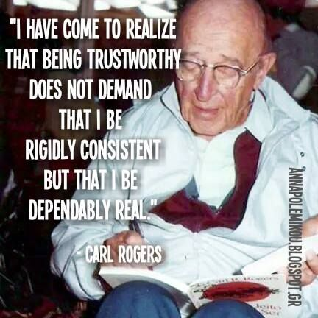
Benefits from use of EBP
  Informing the client of the interventions benefits and risks
  Positive and negative implications
  Further enhances the client- centered environment
  Allows the client to make informed decisions about the services
Notes:
Patients and families use of internet and have to be knowledgeable of what is accurate

Slide 31
How do you become an evidence-based practitioner?
Become Reflective Practitioners
Use of clinical reasoning skills and self- assessment for decision making
Systemic thinking does not cease during the implementation of interventions
OT makes decisions based on feedback from the actual intervention itself AND
From an examination of the therapeutic use of self and other influences on the intervention process

Slide 32
How to Become Reflective Practitioners:
It is:
The thinking and action strategies during the intervention phase of OT practice.
Monitor the client
Collaboration
Professional practice
Setting-based resources
Therapeutic use of self
Other internal & external influences that impact practice process and outcome
Notes:
Family, culture, community, roles, patient priorities, prognosis

Slide 33
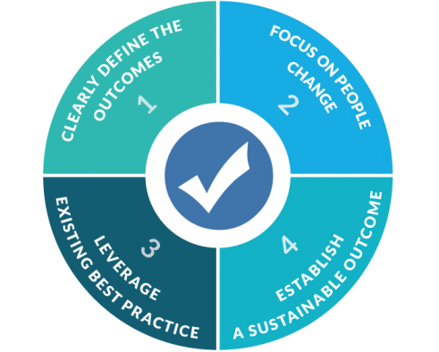
Be the Best Clinician!
  As clinicians, our goal is to put together the best treatment plan that maximizes the patient’s ability to benefit and achieve the best outcome

Slide 34

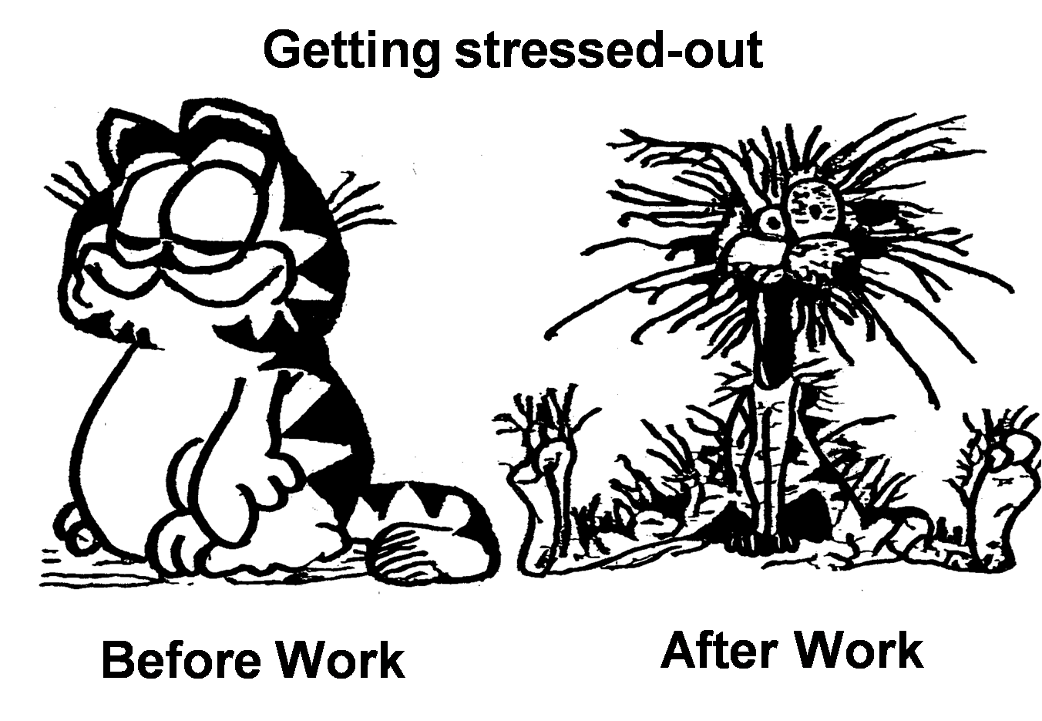
What did I get myself into?
What does all this mean?
4 STEPS:
Pose a clinical question
Search, sort, make sense of the evidence
Appraise the literature
Assess the effectiveness and proficiency with the process of EBP

Slide 35
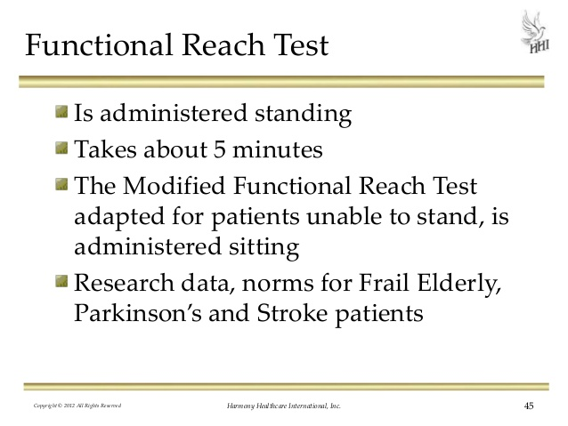
4 STEPS to EBP [Abreu and Chang (2002)]:
1) Framing the Question
Functional Reach and Neuro Client- Assessing Balance
Any topic or area of concern:
  Problem
  Intervention
  Comparison of effectiveness of treatment techniques
Describe the client
  Specific group
  Diagnosis

Slide 36

4 STEPS to EBP [Abreu and Chang (2002)]:
2) Searching, Sorting, and Making Sense of the Evidence:
2) Sorting the Research
Can be overwhelming and seemingly complex unless one understands that research evidence is already categorized and ranked based on the strength or power of the research design, randomization of participants in the study, and the clinical significance of the research findings.

Slide 37
4 STEPS to EBP [Abreu and Chang (2002)]:
2) Searching, Sorting, and Making Sense of the Evidence:
Where do I start?
Randomized Controlled Trial (RCT)
  “Gold Standard” in research due to randomization.
Meta-analysis
  “Supersized” research
  Combines & analyzes the results of known trials of intervention/topic
These are the most powerful and highly respected forms of research
A meta-analysis that is limited to RCT is noted to be the most powerful evidence that is easily generalized to clinical practice

Slide 38
4 STEPS to EBP [Abreu and Chang (2002)]:
3) Appraise the literature
The “power” of a study is determined statistically by having:
  the right number of participants in the study for the data gathered to show a significant change from pre- to post-test
  OR
  Significant difference in a comparison with a treatment group
  Keep in mind that our consumers are clever, and have easily accessible information.
  We need to be prepared to share their knowledge, expertise, and evidence with the consumer. They will ask, “ What is the evidence for what you do?”

Slide 39
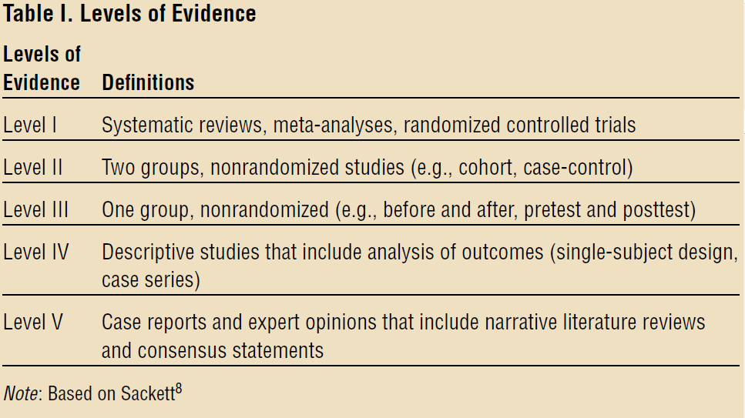
Levels of Evidence for Occupational Therapy Literature
Research Reviews
3) Appraise the literature
Higher Levels of Evidence (I and II) are less vulnerable to BIAS and more generalizable to groups and individuals , more valid and reliable.
Have a control group *

Slide 40
4 STEPS to EBP [Abreu and Chang (2002)]:
4) Assess the effectiveness and proficiency with the process of EBP
Determine the level of understanding of your client
Do you need an interpreter
Encourage decision-making
Consider their values
What is most important to the client
Improves client-centered approach
Our responsibility to communicate the most valid and reliable methods to the consumer.

Slide 41
4 STEPS to EBP [Abreu and Chang (2002)]:
4) Assess the effectiveness and proficiency with the process of EBP
Summarize the information
Discuss possible outcomes of participation or nonparticipation in treatment
Validate inclusion in the decision-making process using numerical interpretations to enhance understanding
Refrain from using professional jargon
Make information individualized to your patient
If true, state that the evidence may be weak and why
Discuss the cost and benefit of participating or not participating in OT

Slide 42
4 STEPS to EBP [Abreu and Chang (2002)]:
4) Assess the effectiveness and proficiency with the process of EBP
New research is continuously being published
More accessible to improve credibility and improve our practice
Evaluate whether the interventions that YOU choose are simply based on your personal preferences OR
The best choices for the functional outcomes of your clients
Reason to Become a member of the AOTA
Access to new research to assist with quality of services, OT outcome literature and the importance to demonstrate the value of OT interventions.
AOTA’s Evidence-Based Literature Review Project

Slide 43
Clinical Question
1
Search for Best available evidence
2
Critically Analyze the Evidence for Validity and Usefulness
3
Integrate with Clinical Experience and Client preferences
4
Evaluate the Effects and Outcomes
5
Critically Analyze the Evidence for Validity and Usefulness
6
Disseminate and Communicate Knowledge
Notes:
EBP Process (Lin & Murphy, 2010)

Slide 44

Where do I start?
http://www.aota.org/Practice/Researchers.aspx
Common Data Elements (CDE)- Wen, P.S.
Sets of assessments that experts organized based on subject-specific and topic driven data-elements
Select a subject and a topic and get a list of high-quality assessments
http://www.commondataelements.ninds.nih.gov/default.aspx#page=D\efault

Slide 45
Strategies for Incorporating EBP into Fieldwork
Incorporate EBP into the FW objectives
Assign readings for students to learn about certain topics, diagnoses, treatments
Use evidence-based assessments and interventions
Describe the evidence you used to determine your assessments and interventions
Justify and advocate for services based on evidence
Students plan presentations that incorporate evidence
Collaborate with the student to write a Critically Appraised Paper through AOTA’s Evidence Exchange https://www.aota.org/Practice/Researchers.aspx
Collaborate with students to develop evidence-based practice guidelines, protocols or recommendations specific to your setting and client population

Slide 46
Lifelong Learning
This starts in educational institutions
Continues in Fieldwork
A Basis for effective practice

Slide 47
Resources for EBP
Journals
American Journal of Occupational Therapy
Journal of the American Medical Association
Archives of Physical Medicine and Rehabilitation
Developmental and Behavioral Pediatrics
Journal of Pediatrics
Journal of Abnormal Child Psychology
Australian Journal of Occupational Therapy,
New England Journal of Medicine
OTJR
Occupation, Participation and Health
Journal of Rehabilitation Medicine
Journal of Hand Surgery

Slide 48
Resources for EBP
Websites
http://www.aota.org/Practice/Researchers/EBP-Resources.aspx
http://www.aota.org/Practice/Researchers/practice-guidelines.aspx
www.nbcot.org (with membership only)
www.otseeker.com
www.ahrq.gov
http://www.commondataelements.ninds.nih.gov/default.aspx#page=Default
Free Access databases:
www.ncbi.nlm.nig.gov/pubmed
www.cochrane.org
www.ahrq.gov

Slide 49
References
Bergner, J.L. (2018). Field report: navigating fieldwork placements using occupation-based models. OT Practice, 23(8), 14-17. http://doi.org/10.7138/otp.2018.2308.field
Meriano, C. & Latella, D. (2016). Occupational therapy interventions: Function and occupations. (2nd ed.). Thorofare, NJ: Slack.
Pendleton, H. M., & Schulttz-Krohn, W. (Eds.). (2013). Pedretti’s: Occupational therapy: Practice skills for physical dysfunction. (7th ed.). St. Louis, MO: Elsevier.
Sladyk, K. (Ed.). (2015). Ryan’s occupational therapy assistant: Principles, practice issues, and techniques. (5th ed.). Thorofare, NJ: Slack.
Wen, P. S. “Have you Heard of Common Data Elements” FOTA newsletter

